Slide 1

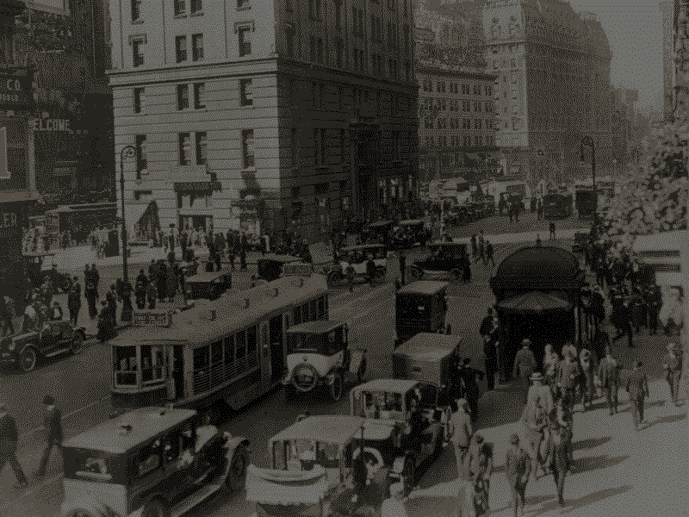

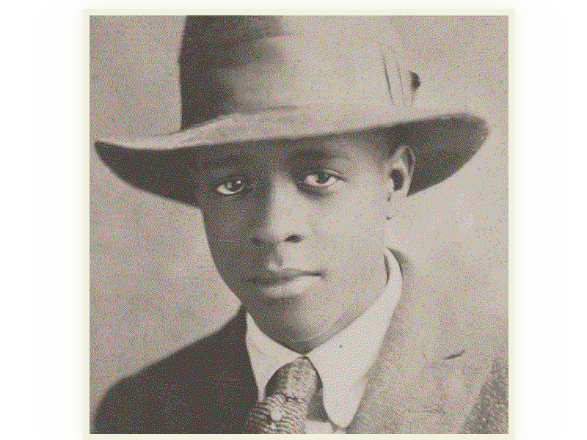
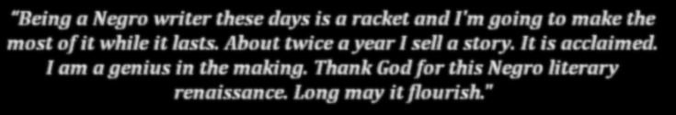
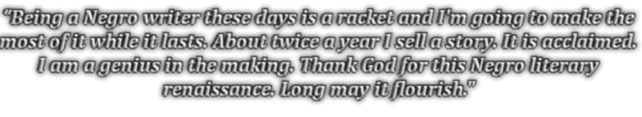
American Novelist
Newspaper Publisher
Essayist
American Novelist
Newspaper Publisher
Essayist

Slide 2
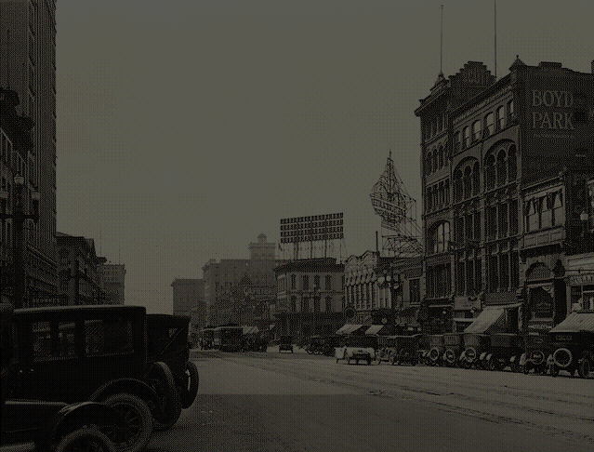
== ABOUT ==
Born in Salt Lake City, Utah (image in background)
Writer, newspaper publisher during Harlem Renaissance
Had a lonely early life, his father abandoned his family.
- Background : Main Street Looking South (Salt Lake City 1920) (https://www.flickr.com/photos/marriottlibrary/2755364517)
- Info : “Encyclopedia of Harlem Renaissance” pg 328 ; Blackpast.org - WALLACE THURMAN (1902-1934)

Slide 3
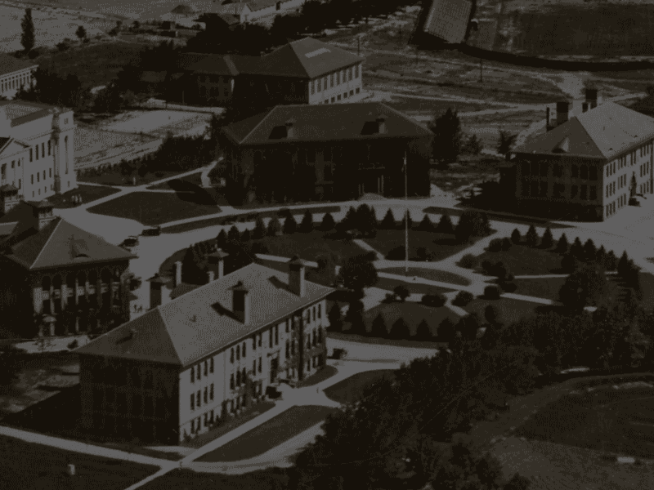
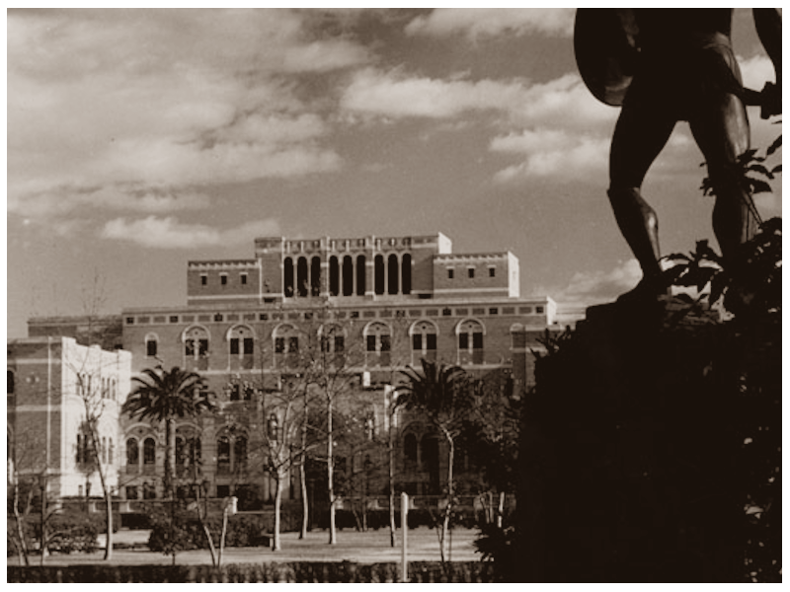
== Education==
Went to premedical study at University of Utah (background image) after graduated high school
Is said to be intellectually gifted, studied there from 1919-1920
Transferred to University of Southern California in 1922 to study journalism
University of Southern California in 1930s
(from waterandpower.org, digitally altered)
Background : University of Utah campus close-up 1920s, from wikimedia.org
(https://upload.wikimedia.org/wikipedia/commons/8/8c/UofU_campus_close-up_early_1920s.jpg)
- Info : “Encyclopedia of Harlem Renaissance” pg 328 ; Blackpast.org - WALLACE THURMAN (1902-1934)

Slide 4
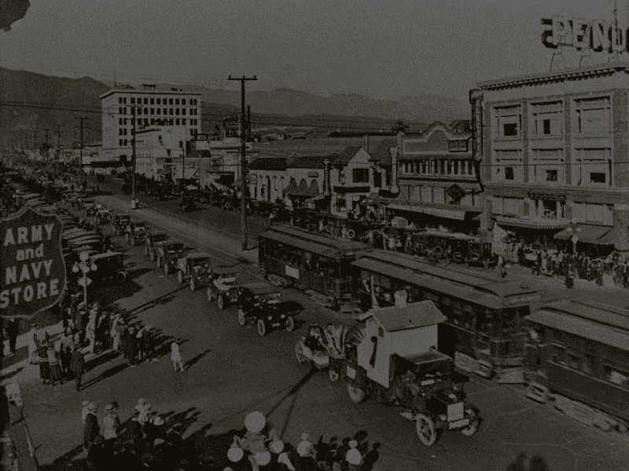
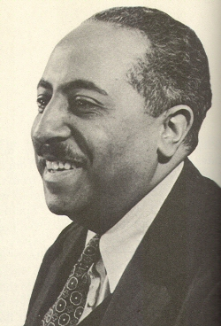
== Start of journey==
After dropping out without a degree, he worked at a post office where Arna Bontemps worked (another novelist in Harlem Renaissance)
Both became a reporter and columnist for a black-owned newspaper
Started a magazine, artistic journal named “Outlet”, ran for only 6 months
(no online images found)
Arna Bontemps, who worked
with Thurman
(image from Blackpast.org)
Background : Los Angeles in 1920s, same city Thurman worked, image from metroprimaryresources.info
(https://metroprimaryresources.info/past-visions-of-los-angeles-transportation-future-1920s/)
- Info : “Encyclopedia of Harlem Renaissance” pg 328 ; Blackpast.org - WALLACE THURMAN (1902-1934)

Slide 5
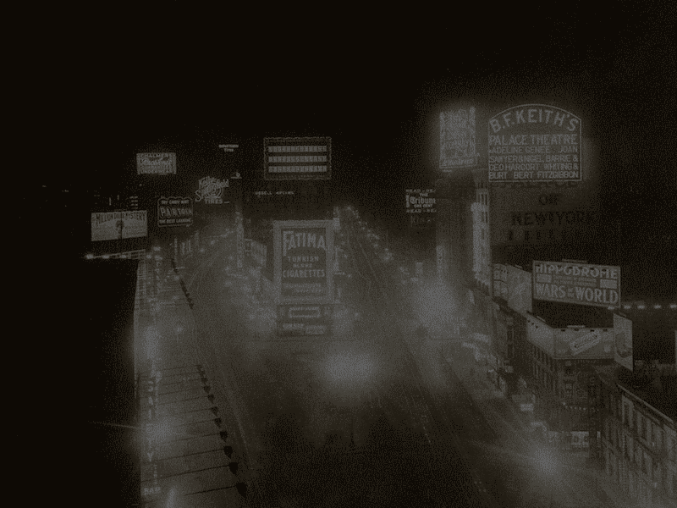




== The “rise” ==
Moved to Harlem, New York (background image), he worked as a writer, editor and publisher
Collaborated in making “Fire!! A Quarterly Devoted to the Younger Negro Artists” ,a magazine showing real lives of African Americans instead of propaganda
Covered controversial topics like homosexuality, interracial relationships, etc...
-> Poor reception, some readers found it offensive. But some applauded for it unique qualities

Slide 6
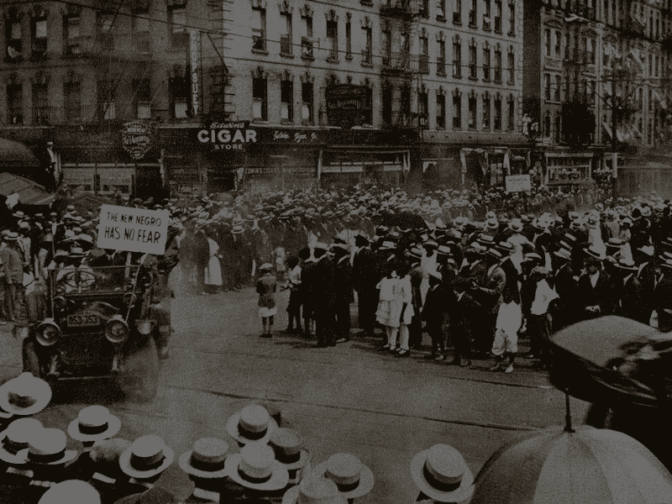
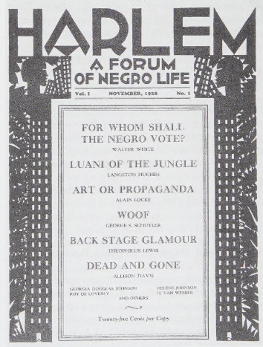
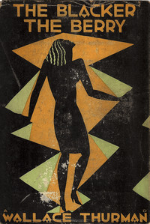
== The journey goes on==
He continued editing and writing, edited and published works such as “Harlem: A Forum of Negro Life” and “The Blacker the Berry: A Novel of Negro Life”, which explored intra-racial conflicts, colorism and discrimination, now recognized as a groundbreaking work of fiction.
Became a reader for a major New York publishing company, becoming the first African American ever in such position
Background : New Negro parade in Harlem, 1920
(https://en.wikipedia.org/wiki/New_Negro#/media/File:UNIA_parade_in_Harlem,_1920.jpg)

Slide 7
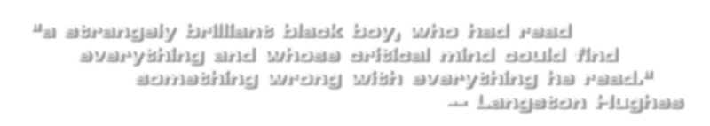

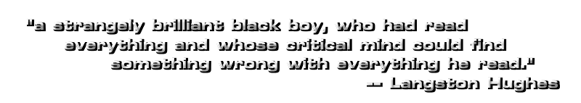
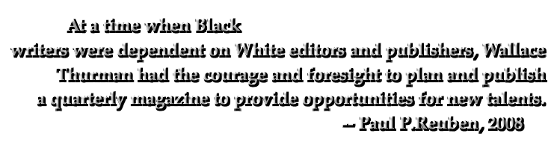

== The Legacy ==
With his commitment to individuality and objectivity, his quality and personality, he has left a mark in the Harlem Renaissance by being one of the leading novelists, established himself as a pioneer and literacy revolutionary

Slide 8
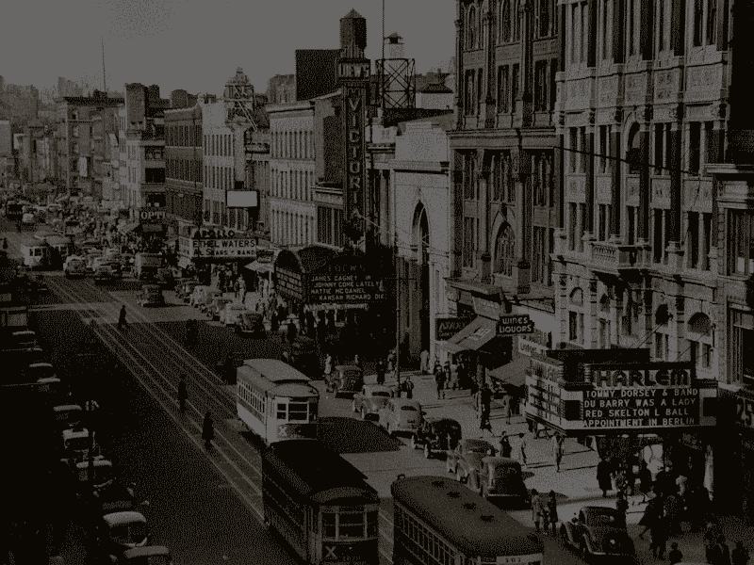
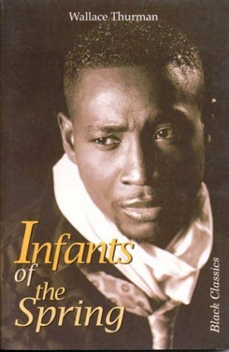
== The End ==
Passed away on December 22nd, 1934 at the age of 34 by tuberculosis, a bacterial disease that affects the lungs. Many suspected was caused by his long fight with alcoholism
Though his life was cut short, his effort and commitment to unvarnished realism has made him a pioneer, unique novelist and established an unforgettable mark in the modern world
“Infants of the Spring”
Another novel made by Wallace Thurman
“Thurman had established himself as a pioneer and literary revolutionary who left an enviable written record as a legacy.” –Wilfred D.Samuels

Slide 9
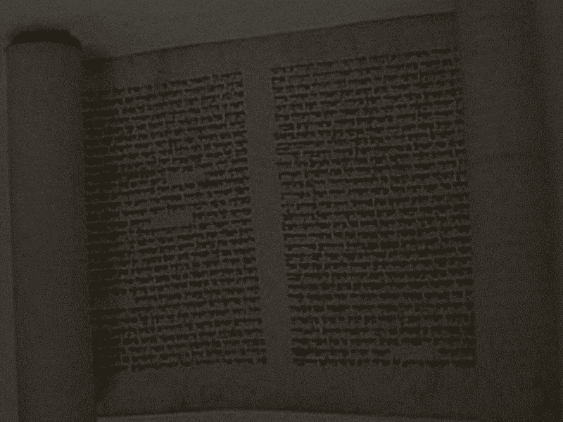
== Sourcing ==
Info : www.kennedy-center.org | www.myblackhistory.net
www.csustan.edu | www.blackpast.org
legacyprojectchicago.org | mappingliteraryutah.org
wikipedia.org | Encyclopedia of the Harlem Renaissance
Image: wikimedia.org | www.myblackhistory.net
flickr.com | metroprimaryresources.info
Background : History of scrolls
(https://en.wikipedia.org/wiki/History_of_scrolls)

Slide 10
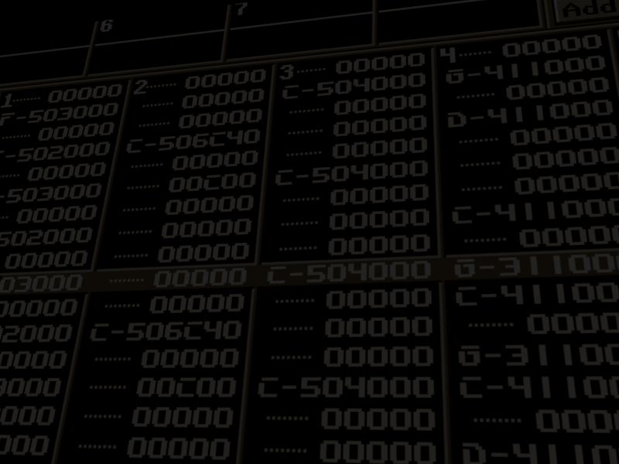
== True end ==
Presentation made by
Varik/Trung Tri Nguyen
Software used: Microsoft PowerPoint
GNU Image Manipulator | paint.net
Snipping Tool | FastTracker2
Background : History of scrolls
(https://en.wikipedia.org/wiki/History_of_scrolls)

